Slide 1
HOUSE DATA ANALYSIS
JANE NJUGUNA
SHILTON SOI
NICOLE NYAGAKA
MONICA MWANGI
LOISE MBURUGA

Slide 2
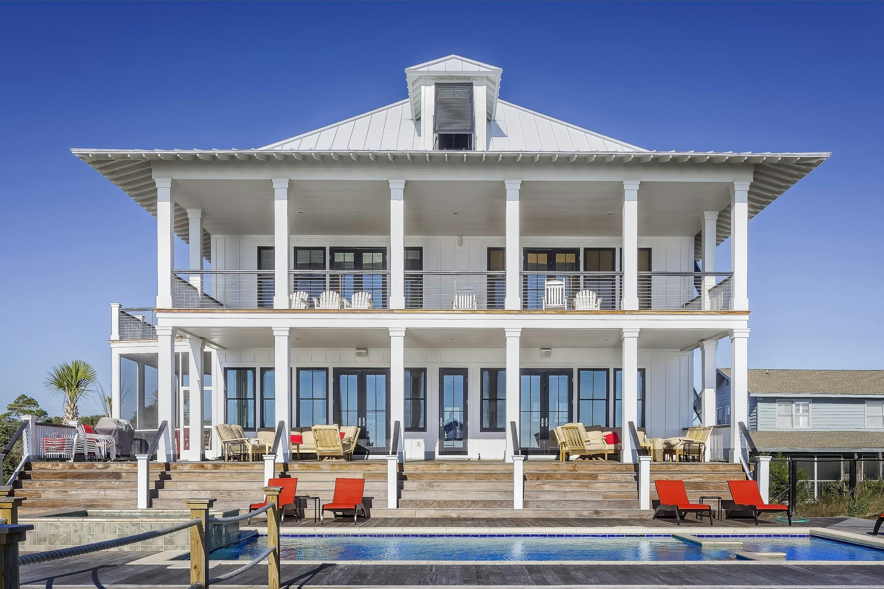

Slide 3
INTRODUCTION
In the fast paced world of real estate, real estate agencies guide homeowners through crucial decisions like pricing, market analysis, and property inspections.
This project aims to equip agencies with a powerful regression-based tool, which will predict property value while analyzing various variables that may affect price.

Slide 4
PROBLEM STATEMENT
What is the problem
A real estate agency in King County seeks to provide advice to homeowners on how renovations could increase estimated value of their homes but lacks data.
How to solve the problem
Construct a predictive regression model that aids real estate agencies in empowering clients on making informed decisions on property prices

Slide 5
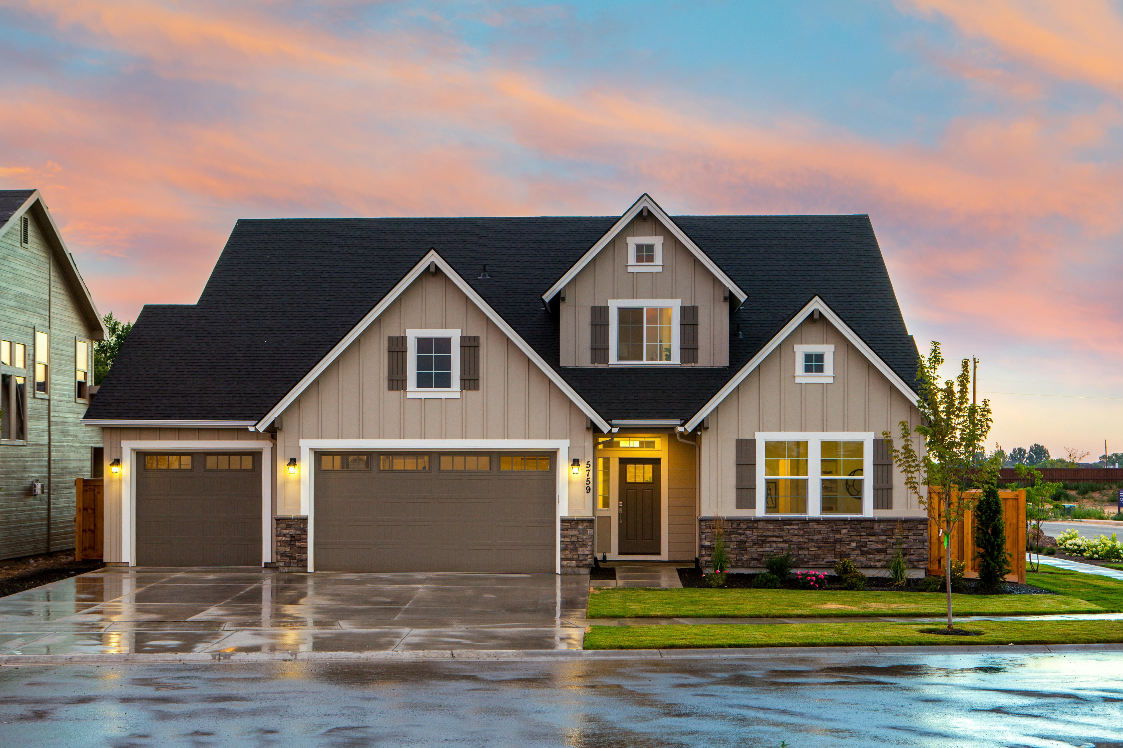
OBJECTIVES
Main Objective:
To aid real estate agencies in advising clients on house prices.
Specific Objectives:
i). Identify Key Factors Influencing House Prices
ii). Effectiveness ways to predicting house prices.
iii). Provide suggestions to real estate agencies for enhancing profitability and market presence

Slide 6
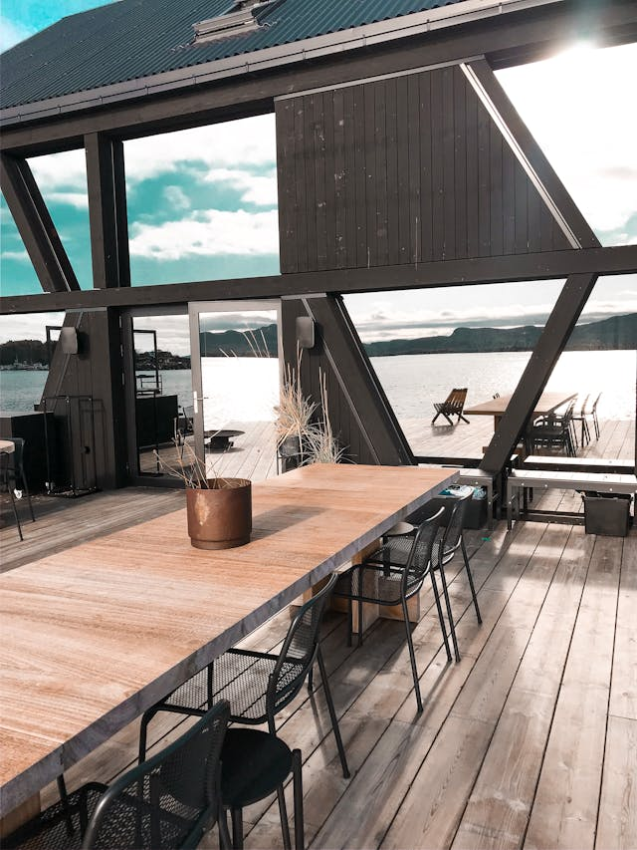
BUSINESS UNDERSTANDING
King County, Washington, located in the northwestern United States, boasts a vibrant housing market anchored by the bustling city of Seattle.
Over the years, the county has seen remarkable growth, driven by its thriving economy and cultural significance. This has attracted a surge of residents, spurring high demand for housing across urban and suburban landscapes.
Seattle, renowned for its striking skyline, has become particularly desirable for tech professionals and city enthusiasts alike. Known for its competitiveness, King County's real estate market offers diverse neighborhoods catering to various preferences, from historic districts to contemporary suburban developments.

Slide 7
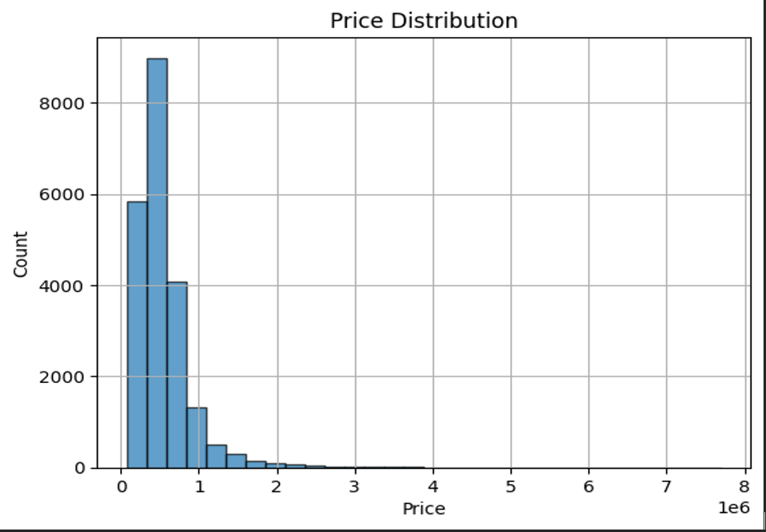
PRICING DISTRIBUTION
This graph shows the price distribution of houses and shows most houses cost less than 1000000

Slide 8
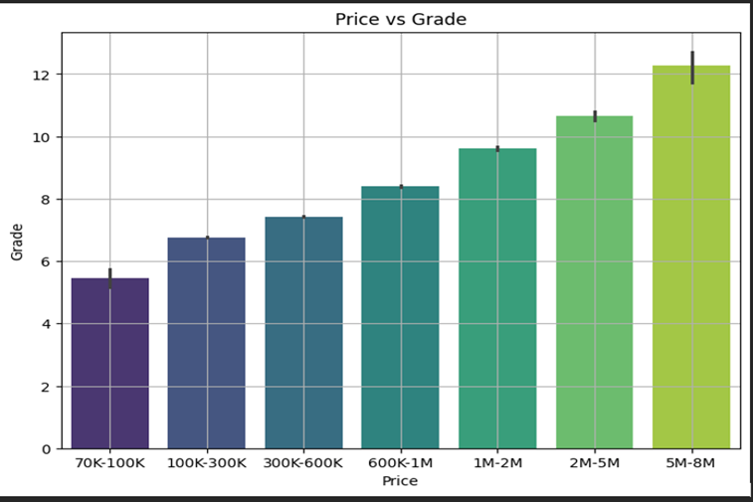
CHANGES IN PRICE COMPARED TO CHARACTERISTICS
Houses with higher grades tend to be of higher quality therefore they also have a higher price, for instance houses worth about 80,000 tend to have a lower grade (5 - 7) while houses worth about 6,000,000 tend to have a higher grade (12 - 13). Since most houses cost less than 1,000,000, from this graph we can conclude that most houses have a grade of 7(average) and 8 (good)

Slide 9
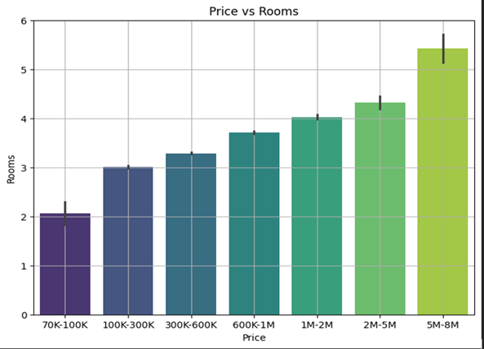
According to this graph, house prices increases with number of rooms, therefore houses with 5 or more rooms sell at around 5,000,000 while those with 2 or less rooms sell at around 70,000. We can also conclude that most houses have less than 4 bedrooms and the ones that have 4 or more bedrooms cost more than 1,000,000

Slide 10
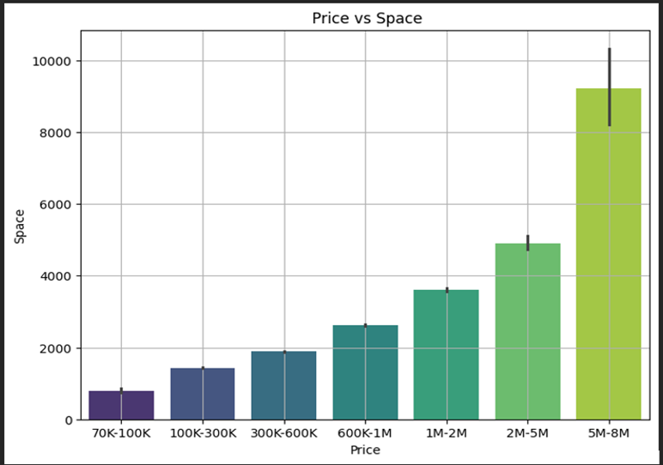
This graph shows that bigger houses tend to have a higher price, so a house worth about 90,000 is expected to be smaller than a house worth about 6,000,000.
We know that most houses cost less than 1,000,000 therefore, this indicates that most houses have less than 3000 square feet of living space and Houses with more than 4000 square feet of living space cost from 2,000,000

Slide 11
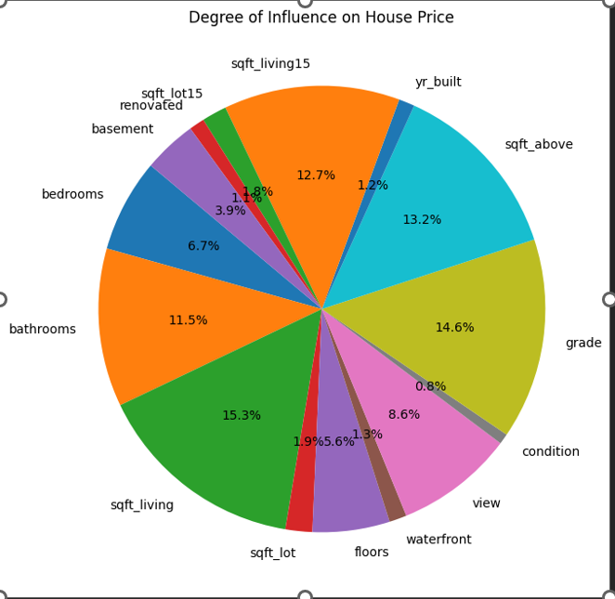
INFLUENCE OF PROPERTY CHARACTERISTICS ON PRICE
The pie chart shows what buyers in this area prioritize when looking to buy a house.
It indicates how much influence house variables have on the house price.
-sqft_living has significant influence on price at 15.3%.
-Renovation status has less significant influence on price at 1.1%

Slide 12
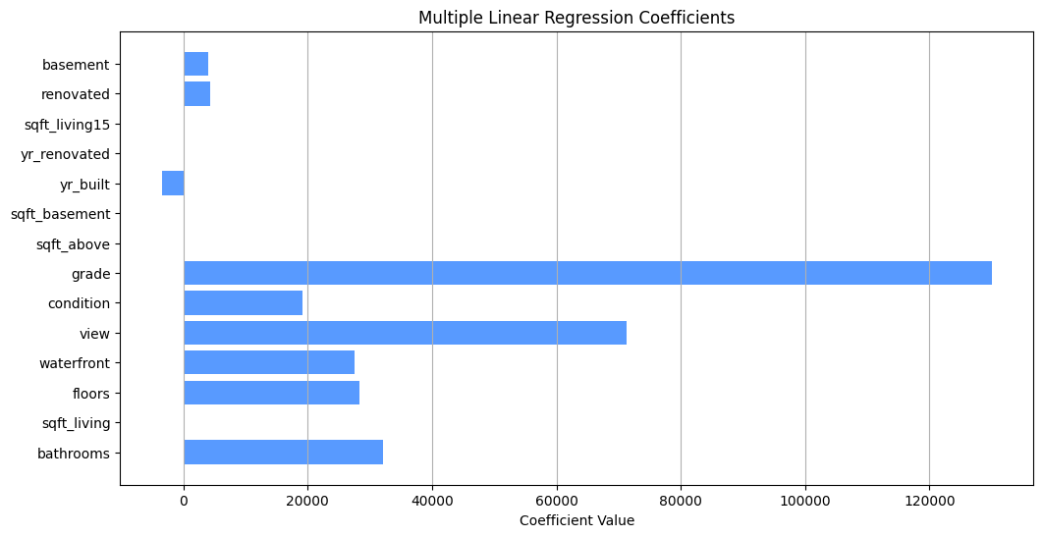
Factors to consider in pricing
Key features such as bathrooms, square footage, waterfront views, condition, grade, and year built demonstrate significant impacts on prices.

Slide 13
CONCLUSION AND RECOMENDATIONS
When pricing houses, real estate agents should consider features such as bedrooms, bathrooms, living space, basement space, floors, waterfront location, view, condition and grade.
Renovating older houses will also increase the prices of houses.

